Slide 1


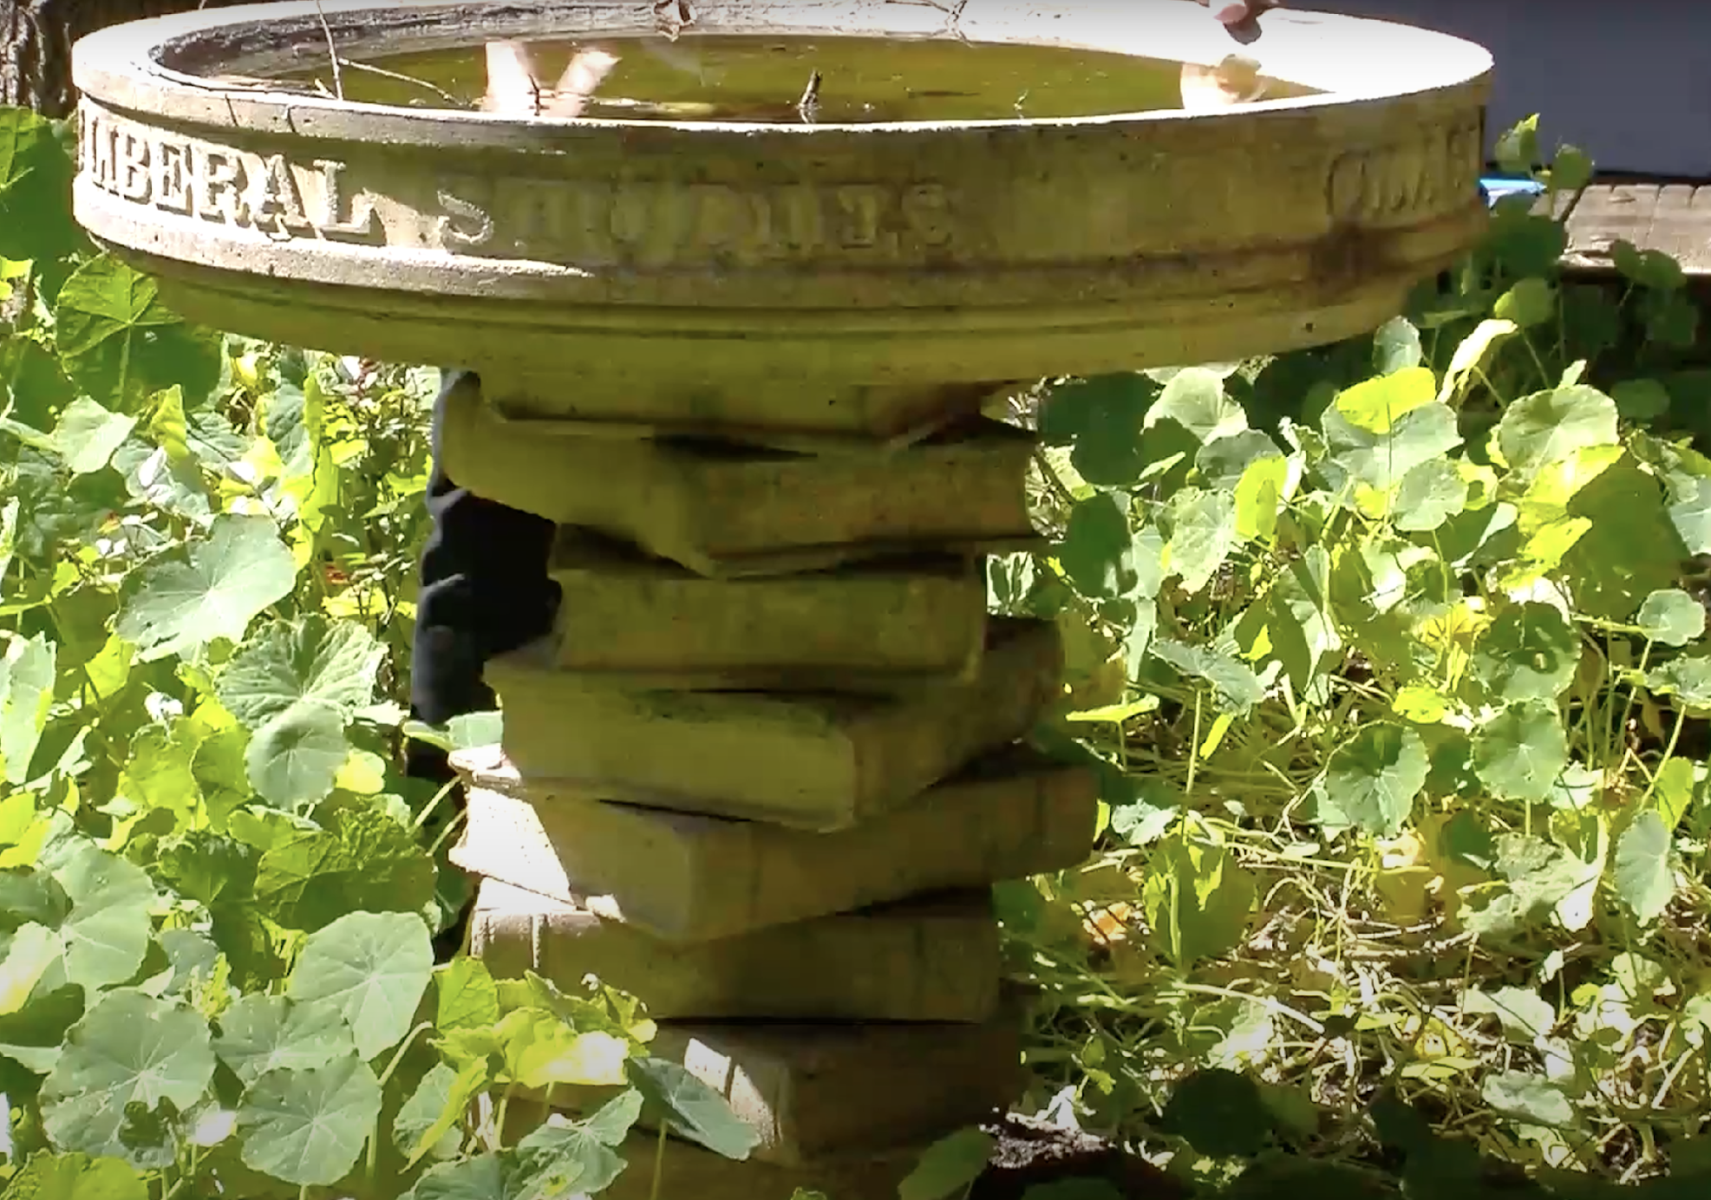
The Hutchins School of Liberal Studies
Hutchins is the Liberal Studies major @ SSU
We are an interdisciplinary school within the School of Arts & Humanities
Liberal Studies is an excellent major for careers requiring strong critical thinking and communication skills
Hutchins offers 3 major concentrations including 2 elementary teacher tracks, a minor and GE learning community courses

Slide 2
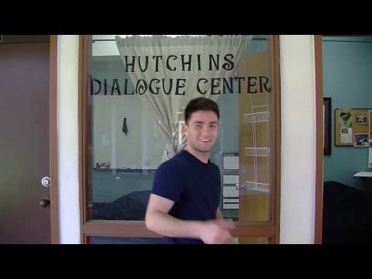
An Introduction to Hutchins: what makes us different
◤

Slide 3

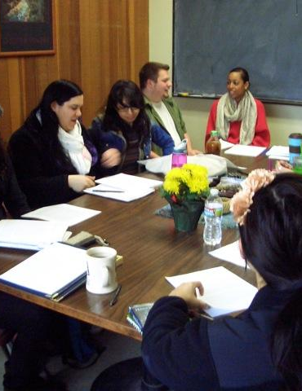
The Hutchins difference:
Student-centered classes that teach critical thinking, self expression & lifelong learning
Emphasis on developing reading, writing, speaking & listening skills
Small seminars with individual attention from faculty
Topical, thematic courses from an interdisciplinary perspective
The highest 4 year graduation rate & one of the highest 2 year graduation rates @ SSU

Slide 4
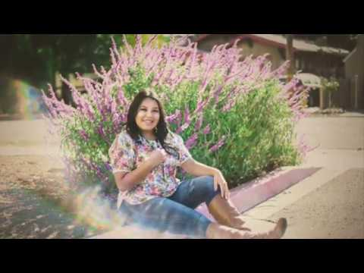
What is a Liberal Arts Education?
“A liberal arts education ...does prepare you for the world of work by providing you with an invaluable set of skills including the ability to think for yourselves, the skills to communicate effectively, and the capacity for lifelong learning.”
-- Monserrat Salas, Hutchins Track II major, SSU Class of 2020 graduate with honors and distinction and recipient of the EOP Outstanding Excellence in Leadership Award.

Slide 5
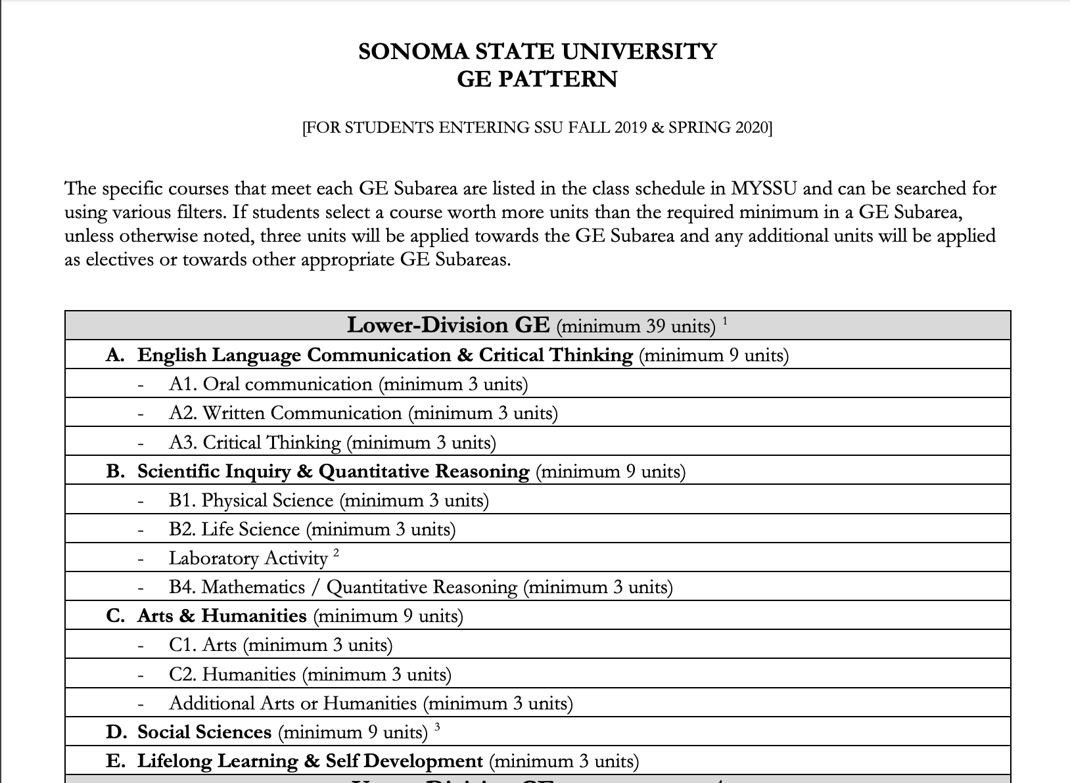
Do GE with us!
LIBS 101 FLC is open to all SSU Students
LIBS 101 (9 units) fulfills GE A2, B2+B3, C1
You can take it instead of ENGL 100A or ENGL 101
Hutchins covers ALL SSU lower division General Education requirements in just 4 courses (with the exception of B4 math): LIBS 101, 102, 201, 202
Students take part in a learning community of small seminars that meet twice a week and a weekly group symposium for speakers, workshops, films, and activities.
There are no tests – the learning happens through reading, writing, thinking, speaking and listening.
Students also take LIBS 103 (1 unit) college transition course. EOP students take UNIV 102 EOP Academy.
◤
PUERTA and EOP students should enroll in LIBS 101 with Professor Mercy Romero
LIBS 101.009 MWF 9-11:40am
Class # 1796

Slide 6
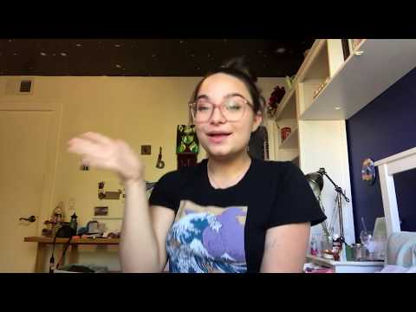
What makes the Hutchins learning community a great choice:
“It’s a really cool way to learn… it’s about helping you learn your best.”
-- Isabela Ucio, Hutchins Track II sophomore and Summer Bridge leader

Slide 7
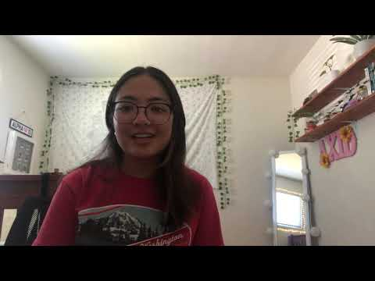
An Introduction to the three Hutchins major concentrations:
◤
“The great thing about Track III is that it accelerates your way into teaching in your own classroom.”
-- Sophia Tsue, Hutchins Track III Blended sophomore and PUERTA student

Slide 8
Liberal Studies Major Concentrations:
Track I Interdisciplinary Studies
Track I Hutchins graduates have had career success in the following fields:
Law, Library Science, Social Work, Counseling, Public Policy, Journalism, Business, Human Resources, Education Administration, High School and College Level Teaching.
Track 1 prepares students to enter a wide variety of careers that don’t require a specific Bachelors degree.
It’s a highly customizable pathway that includes the Hutchins core seminar curriculum, internships, independent study, and an “Area of Emphasis” designed by the individual student.

Slide 9
Liberal Studies Major Concentrations:
Track II Elementary Teacher Preparation
A California Commission on Teacher Credentialing approved program, Track II covers the content knowledge required for elementary school educators.
Track II prepares students to enter a multiple subject or education specialist teaching credential program after they have earned their LIBS BA.
Track II is a great choice for teacher preparation students who are interested in the following options:
Study Abroad, adding a minor or double major, Spanish Bilingual Supplemental Authorization, pursuing an Education Specialist credential.

Slide 10
Liberal Studies Major Concentrations:
Track III Blended LIBS BA + Credential Program
An accelerated course of study. Students complete BOTH the LIBS teacher preparation major AND earn a multiple subject teaching credential from the SSU School of Education in 4 years.
The Track III Blended Program must be started in your first semester at SSU.
Track III Blended Program is an excellent choice for students who know they want to become elementary school educators and want to save time and money on college.

Slide 11
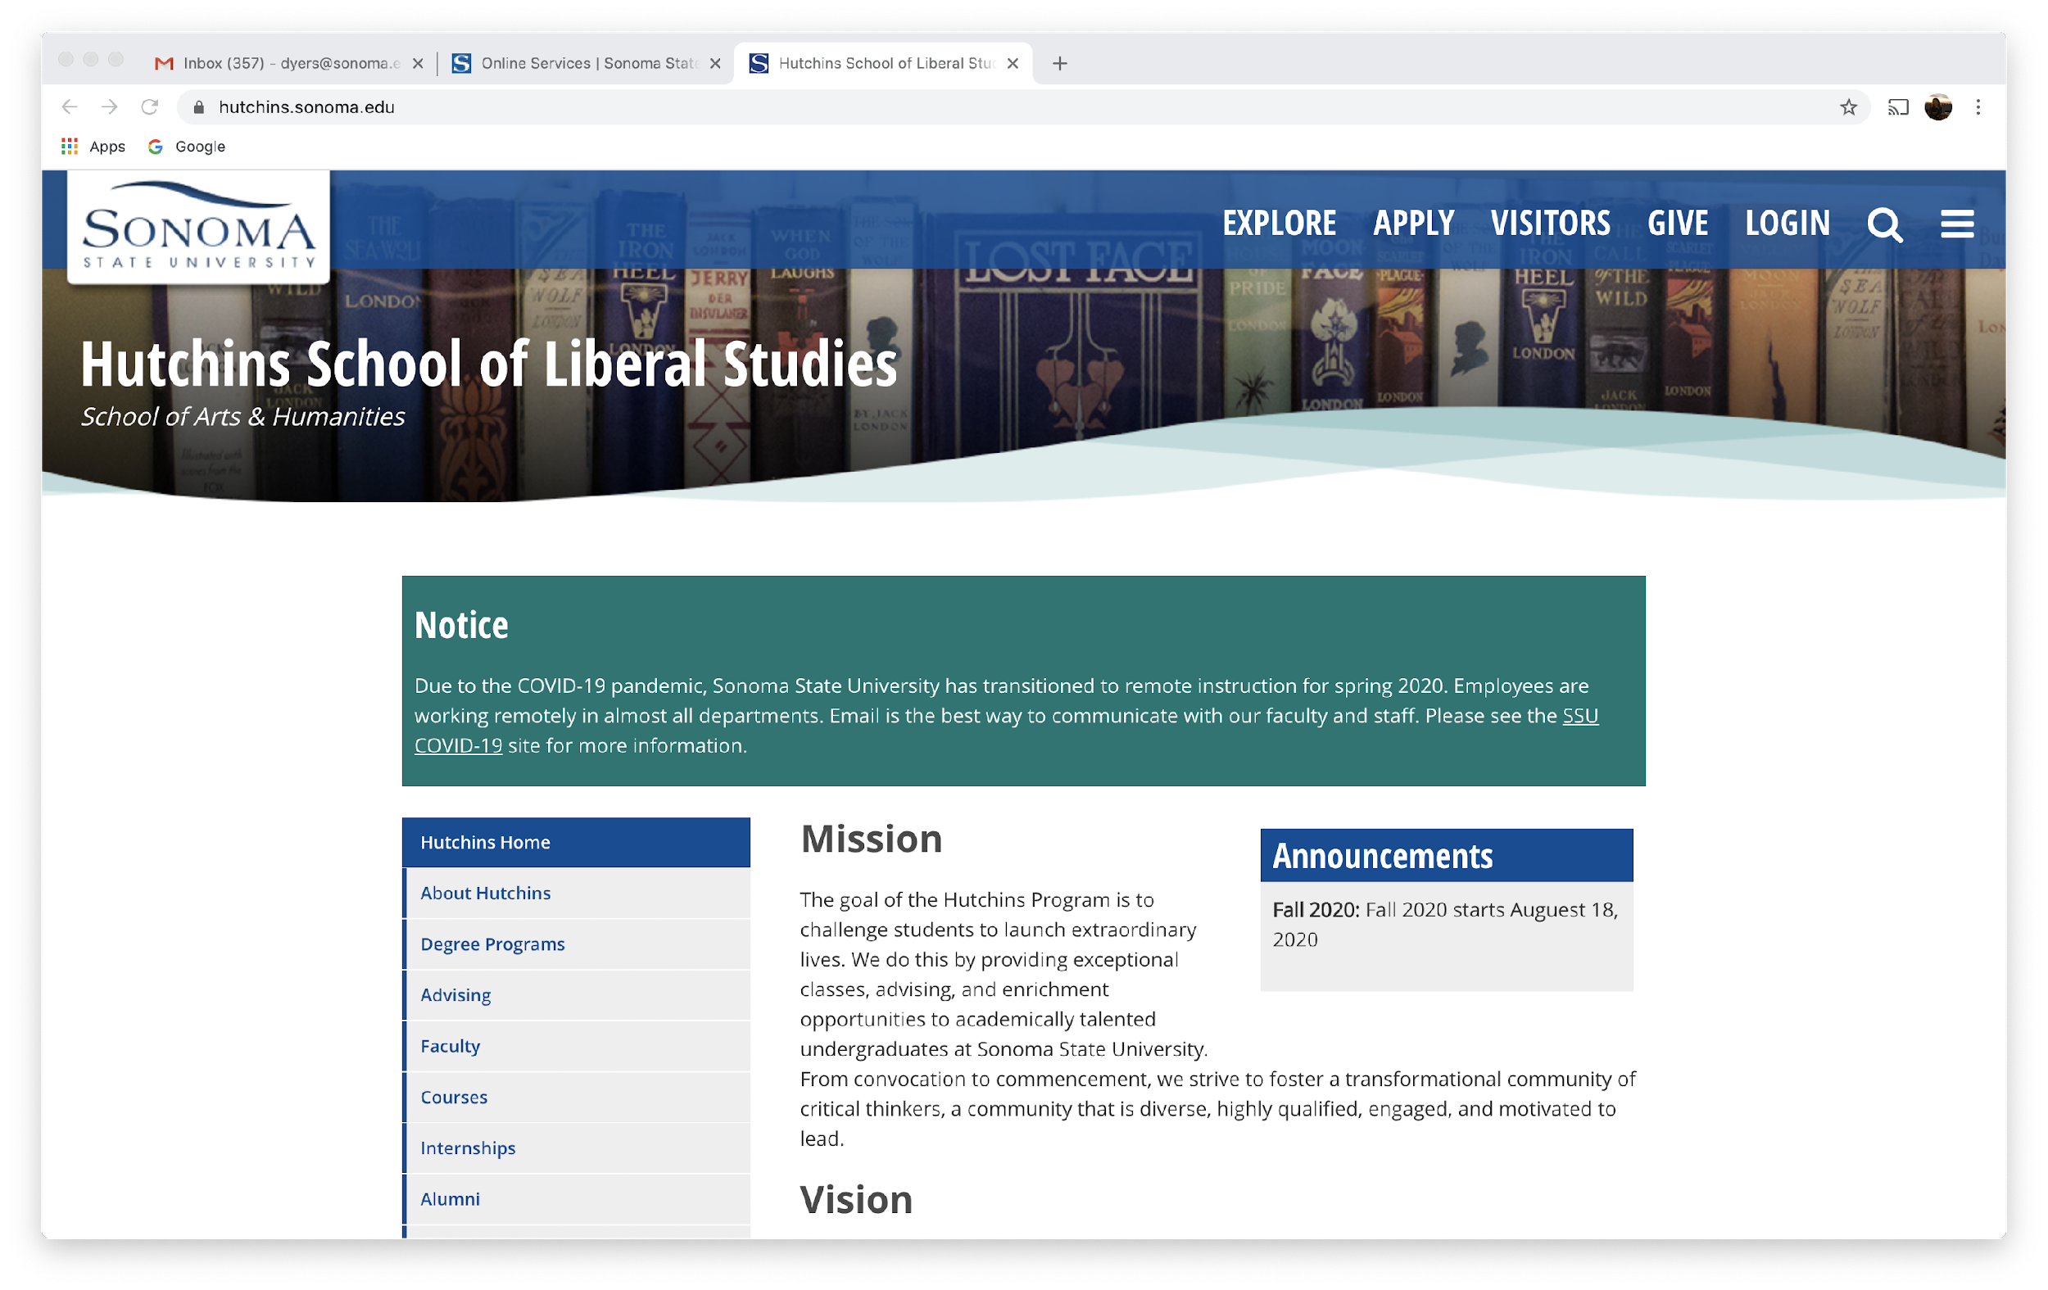
Want to learn more about Hutchins?
Email Hutchins Administrative Coordinator Billie Johnson: bartletb@sonoma.edu
Email Hutchins Department Chair Stephanie Dyer: dyers@sonoma.edu
Check out the Hutchins website: http://hutchins.sonoma.edu/

